Slide 1
Statistical Analysis in G-SRS
Part II
Samir Lababidi
Lawrence Callahan
FDA Office of the Commissioner
Office of the Chief Scientist
Office of Health Informatics
10/30/2019

Slide 2
Comparing Drugs in G-SRS
Profiles of drugs in term of their adverse event using:
  Existence of AE
  Count of AE
  Signal strength of AE

Slide 3
Proportional Reporting Ratio (PRR)
Definition: PRR is the degree of disproportionate reporting of an AE for a product of
interest compared to this same event for all other products
 | Event Y | All other events
Product X | A | b | a + b
All other products | C | d | c + d
 | a + c | b + d | Total
PRR = [a/(a+b)] / [c/(c+d)]
If PRR >> 1 then Event Y is “disproportionately
reported for Product X
Issues with PRR:
It does not adjust for small counts
Every report represents a suspicion of an AE related to a product
Analysis: We transform the PRR values using Log₂

Slide 4
Comparing Drugs in G-SRS
Restricting the data to those with
  Case_Count ≥ 1000 → 16% reduction in the data
Restricting the data further to those with
  PT_COUNT ≥ 5 → less than third of the data
The resulting dataset has 1260 drugs
We only use total number of AEs (PT_TERMs) per drug ≥ 1000

Slide 5
Comparing Drugs in G-SRS
Consider drugs from three classes:
  Metformin: Anti-diabetes
  Prozac (FLUOXETINE): Antidepressant
  Humira (ADALIMUMAB): Monoclonal antibodies

Slide 6
Metformin

Slide 7
METFORMIN Correlation With ALL Other Drugs (N=1259)
Obs | DRUG | COMMON_PT | CORR
1 | GLIMEPIRIDE | 714 | 0.76106
2 | SAXAGLIPTIN ANHYDROUS | 424 | 0.63019
3 | GLYBURIDE | 758 | 0.62519
4 | SITAGLIPTIN | 1345 | 0.61510
5 | GLICLAZIDE | 455 | 0.59429
6 | GLIPIZIDE | 666 | 0.59080
7 | SAXAGLIPTIN | 365 | 0.58894
8 | FUROSEMIDE | 1531 | 0.56176
9 | INSULIN NOS | 756 | 0.55445
10 | HYDROCHLOROTHIAZIDE | 1823 | 0.54705
11 | VILDAGLIPTIN | 367 | 0.54593
12 | ROSIGLITAZONE | 1110 | 0.54547
13 | AMLODIPINE | 1812 | 0.54488
14 | REPAGLINIDE | 306 | 0.52897
15 | LINAGLIPTIN | 510 | 0.52863
16 | EMPAGLIFLOZIN | 425 | 0.52853
17 | PIOGLITAZONE | 1002 | 0.52759
18 | CANDESARTAN | 1032 | 0.52493
19 | IRBESARTAN | 900 | 0.52378
20 | ATENOLOL | 1293 | 0.52295
Obs | DRUG | COMMON_PT | CORR
1240 | CROMOLYN | 269 | -0.39480
1241 | TASIMELTEON | 119 | -0.40107
1242 | THIOTHIXENE | 175 | -0.40881
1243 | CHLORMADINONE | 65 | -0.42287
1244 | IXEKIZUMAB | 269 | -0.42684
1245 | PERMETHRIN | 122 | -0.42701
1246 | HEPATITIS B VIRUS SUBTYPE ADW HBSAG SURFACE PROTEIN ANTIGEN | 98 | -0.43023
1247 | CRISABOROLE | 70 | -0.43097
1248 | BUTOCONAZOLE | 44 | -0.44108
1249 | LEVOMEFOLIC ACID | 138 | -0.44606
1250 | LEVOBUNOLOL | 73 | -0.44983
1251 | DUPILUMAB | 273 | -0.45764
1252 | LEVOMEFOLATE CALCIUM | 129 | -0.46553
1253 | NONOXYNOL-9 | 69 | -0.46699
1254 | ESTRONE | 135 | -0.46891
1255 | ESTROPIPATE | 130 | -0.49338
1256 | ETHYNODIOL | 101 | -0.49672
1257 | NAFARELIN | 147 | -0.49929
1258 | LORACARBEF ANHYDROUS | 118 | -0.51856
1259 | SELENIUM SULFIDE | 29 | -0.67708

Slide 8
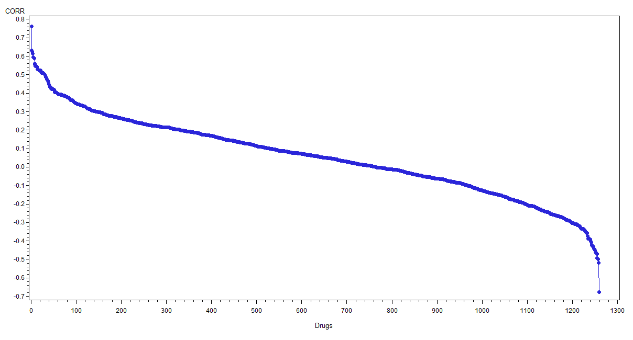
METFORMIN Correlation With ALL Other Drugs (N=1259)

Slide 9
METFORMIN Correlation With ALL Other Drugs (N=1259)
Drugs with the most similar
profile to Metformin

Slide 10
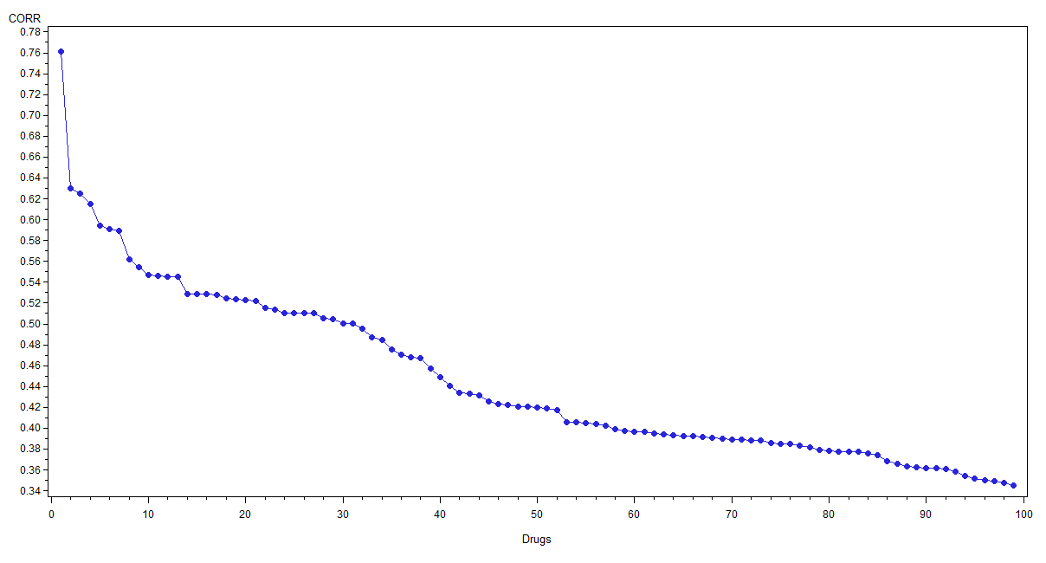
METFORMIN Correlation With ALL Other Drugs
(Top 100 Drugs)

Slide 11
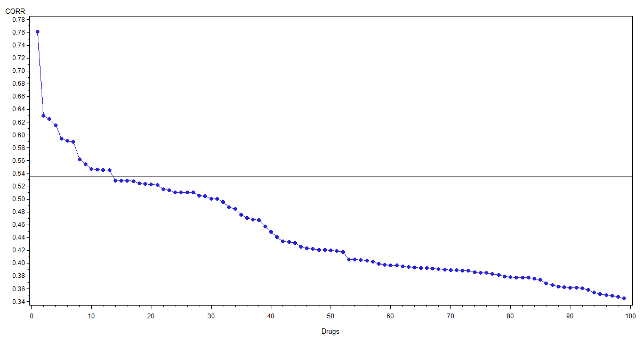
METFORMIN Correlation With ALL Other Drugs
(Top 100 Drugs)
Corr = 0.535

Slide 12
Top Drugs with Similar Profile to Metformin
Obs | DRUG | COMMON_PT | CORR
1 | GLIMEPIRIDE | 714 | 0.76106
2 | SAXAGLIPTIN ANHYDROUS | 424 | 0.63019
3 | GLYBURIDE | 758 | 0.62519
4 | SITAGLIPTIN | 1345 | 0.61510
5 | GLICLAZIDE | 455 | 0.59429
6 | GLIPIZIDE | 666 | 0.59080
7 | SAXAGLIPTIN | 365 | 0.58894
8 | FUROSEMIDE | 1531 | 0.56176
9 | INSULIN NOS | 756 | 0.55445
10 | HYDROCHLOROTHIAZIDE | 1823 | 0.54705
11 | VILDAGLIPTIN | 367 | 0.54593
12 | ROSIGLITAZONE | 1110 | 0.54547
13 | AMLODIPINE | 1812 | 0.54488
FUROSEMIDE: Diuretic Drug
HYDROCHLOROTHIAZIDE: Treats high blood pressure
AMLODIPINE: Treats high blood pressure

Slide 13
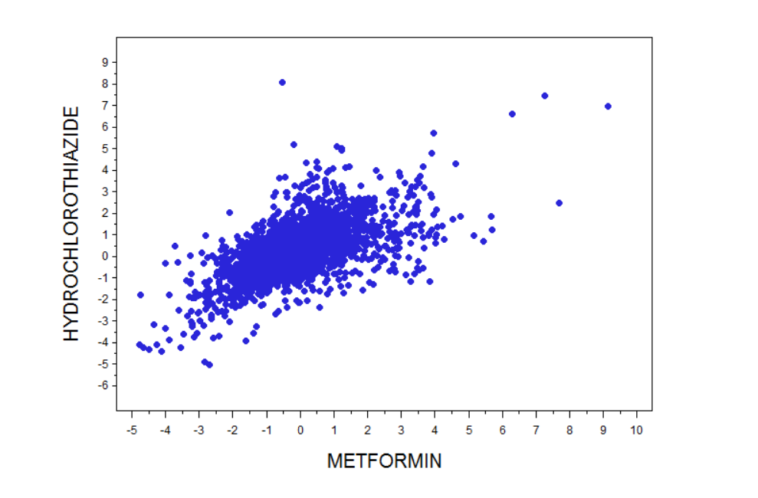
Hydrochlorothiazide versus Metformin (N=1823, Cor=0.547)

Slide 14
Hydrochlorothiazide versus Metformin (N=1823, Cor=0.547)
Sprue-Like
Enteropathy
(Count=1674)

Slide 15
Hydrochlorothiazide versus Metformin
Sprue-Like Enteropathy involves unexpected severe weight loss and severe diarrhea.
  Case Report: Olmesartan Associated Sprue-Like Enteropathy and Colon Perforation, Abdelghany M et al., Case Reports in Gastrointestinal Medicine, Vol. 2014, p3
Olmesartan and hydrochlorothiazide combination is used together with other medicines to treat high blood pressure (hypertension).

Slide 16
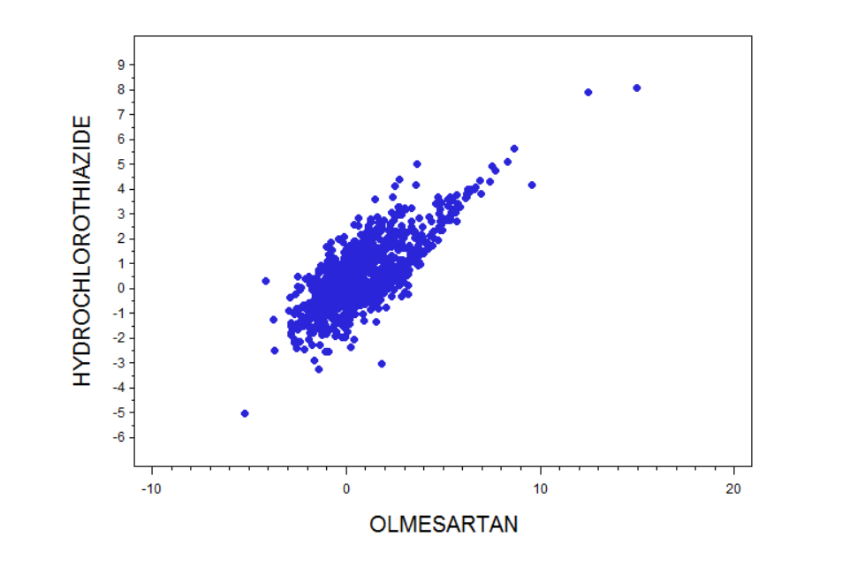
Hydrochlorothiazide versus Olmesartan
(Corr = 0.775, N=1114)

Slide 17
Prozac (FLUOXETINE)

Slide 18
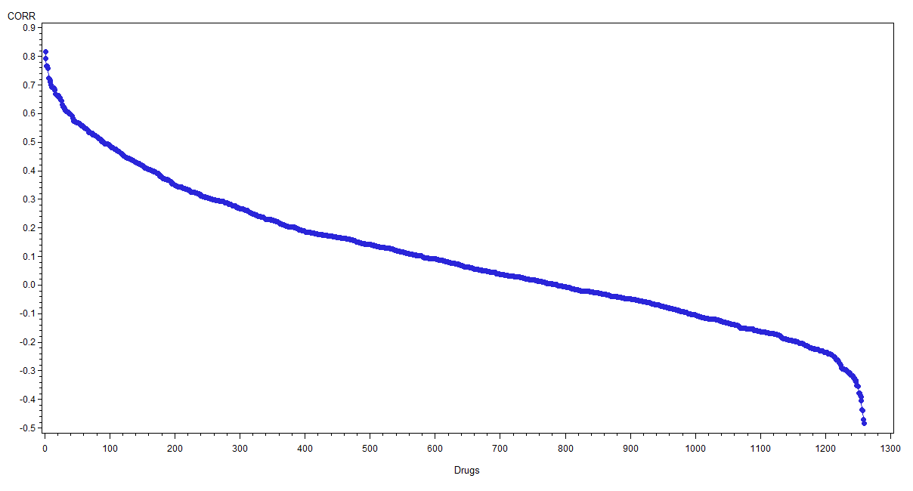
FLUOXETINE Correlation With ALL Other Drugs (N=1259)

Slide 19
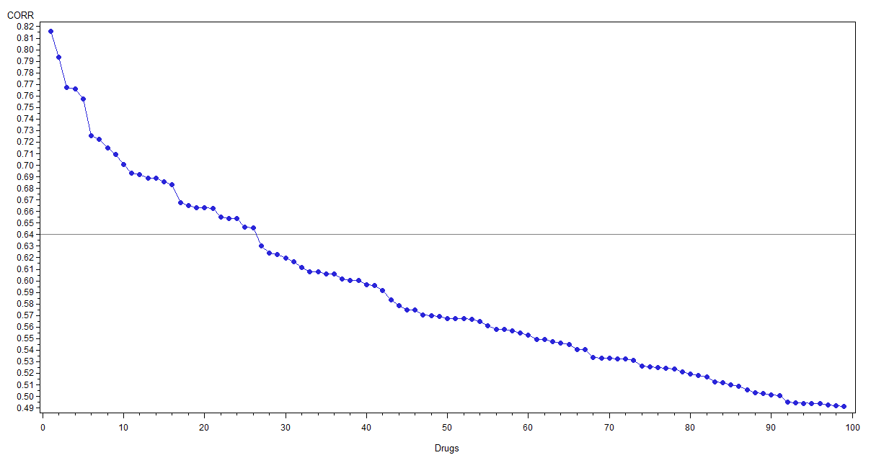
FLUOXETINE Correlation With ALL Other Drugs
(Top 100 Drugs)
Corr = 0.64

Slide 20
Top Drugs with Similar Profile to Prozac
Obs | DRUG | COMMON_PT | CORR
1 | SERTRALINE | 1598 | 0.81563
2 | PAROXETINE | 1513 | 0.79349
3 | CITALOPRAM | 1388 | 0.76736
4 | VENLAFAXINE | 1532 | 0.76581
5 | BUSPIRONE | 543 | 0.75725
6 | ESCITALOPRAM | 1277 | 0.72544
7 | CLOMIPRAMINE | 663 | 0.72245
8 | FLUVOXAMINE | 617 | 0.71493
9 | TRAZODONE | 967 | 0.70964
10 | TRIAZOLAM | 427 | 0.70070
11 | AMITRIPTYLINE | 1167 | 0.69290
12 | PHENELZINE | 335 | 0.69195
13 | CLONAZEPAM | 1349 | 0.68903
14 | LORAZEPAM | 1231 | 0.68862
15 | ALPRAZOLAM | 1377 | 0.68578
16 | NORTRIPTYLINE | 550 | 0.68299
17 | DOXEPIN | 482 | 0.66789
18 | PERPHENAZINE | 299 | 0.66534
19 | IMIPRAMINE | 478 | 0.66321
20 | BUPROPION | 1344 | 0.66308
21 | THIOTHIXENE | 183 | 0.66264
22 | TRIFLUOPERAZINE | 245 | 0.65494
23 | CHLORPROMAZINE | 619 | 0.65421
24 | MIRTAZAPINE | 1178 | 0.65367
25 | DIAZEPAM | 1263 | 0.64652
26 | DESIPRAMINE | 256 | 0.64579
As Prozac, they are Serotonin inhibitors

Slide 21
ADALIMUMAB (Humira)

Slide 22
ADALIMUMAB Correlation With ALL Other Drugs (N=1259)

Slide 23
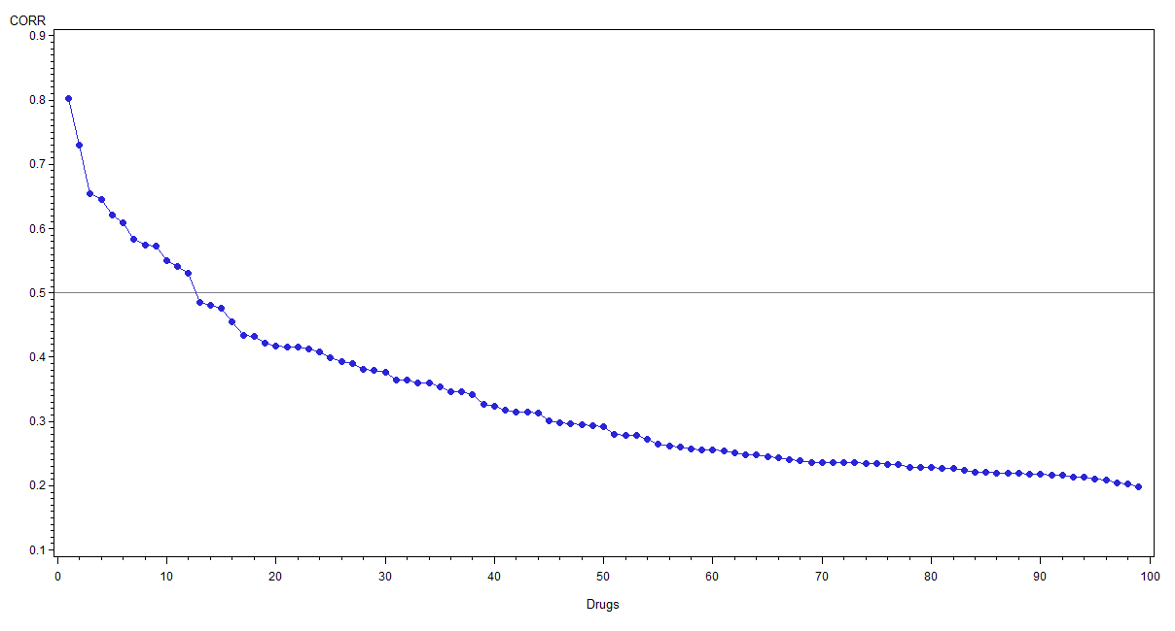
ADALIMUMAB Correlation With ALL Other Drugs
(Top 100 Drugs)
Corr = 0.50

Slide 24
Top Drugs with Similar Profile to Humira
Obs | DRUG | COMMON_PT | CORR
1 | ETANERCEPT | 2375 | 0.80305
2 | CERTOLIZUMAB PEGOL | 1397 | 0.72989
3 | TOFACITINIB | 1325 | 0.65392
4 | GOLIMUMAB | 1168 | 0.64513
5 | SECUKINUMAB | 1168 | 0.62069
6 | ABATACEPT | 1439 | 0.60938
7 | INFLIXIMAB | 2207 | 0.58323
8 | INFLIXIMAB, LICENSE HOLDER UNSPECIFIED | 2196 | 0.57402
9 | IXEKIZUMAB | 284 | 0.57351
10 | VEDOLIZUMAB | 773 | 0.55046
11 | USTEKINUMAB | 1143 | 0.54175
12 | TOCILIZUMAB | 1595 | 0.53000
As Humira, these drugs act as
TNF inhibitors, except TOFACITINIB

Slide 25
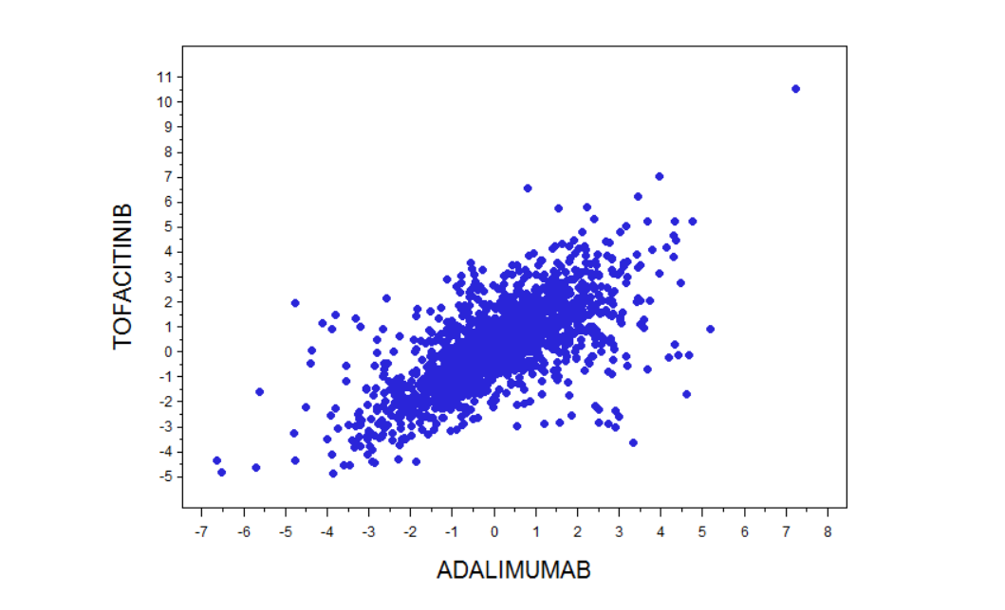
Tofacitinib versus Adalimumab (N=1325)

Slide 26
Tofacitinib versus Adalimumab (N=1325)
Injection
Site Pain
(Count=44)

Slide 27
Tofacitinib versus Adalimumab (N=1325)
Prescribed
Overdose (Count=95)
Injection
Site Pain
(Count=44)

Slide 28
Tofacitinib versus Adalimumab (N=1325)
Tofacitinib is Janus kinase inhibitor, effective in treating RA patients
JAK/STAT activation plays a pivotal role in TNF-alpha mediated gliostatin in RA
  The Janus kinase tofacitinib inhibits TNF-alpha-induced gliostatin expression in rheumatoid fibroblast-like synoviocytes, Kawaguchi Y et al., Clin Exp Rheumatol, 2018, 36(4): 559-567.

Slide 29
Thank You!

